Slide 1
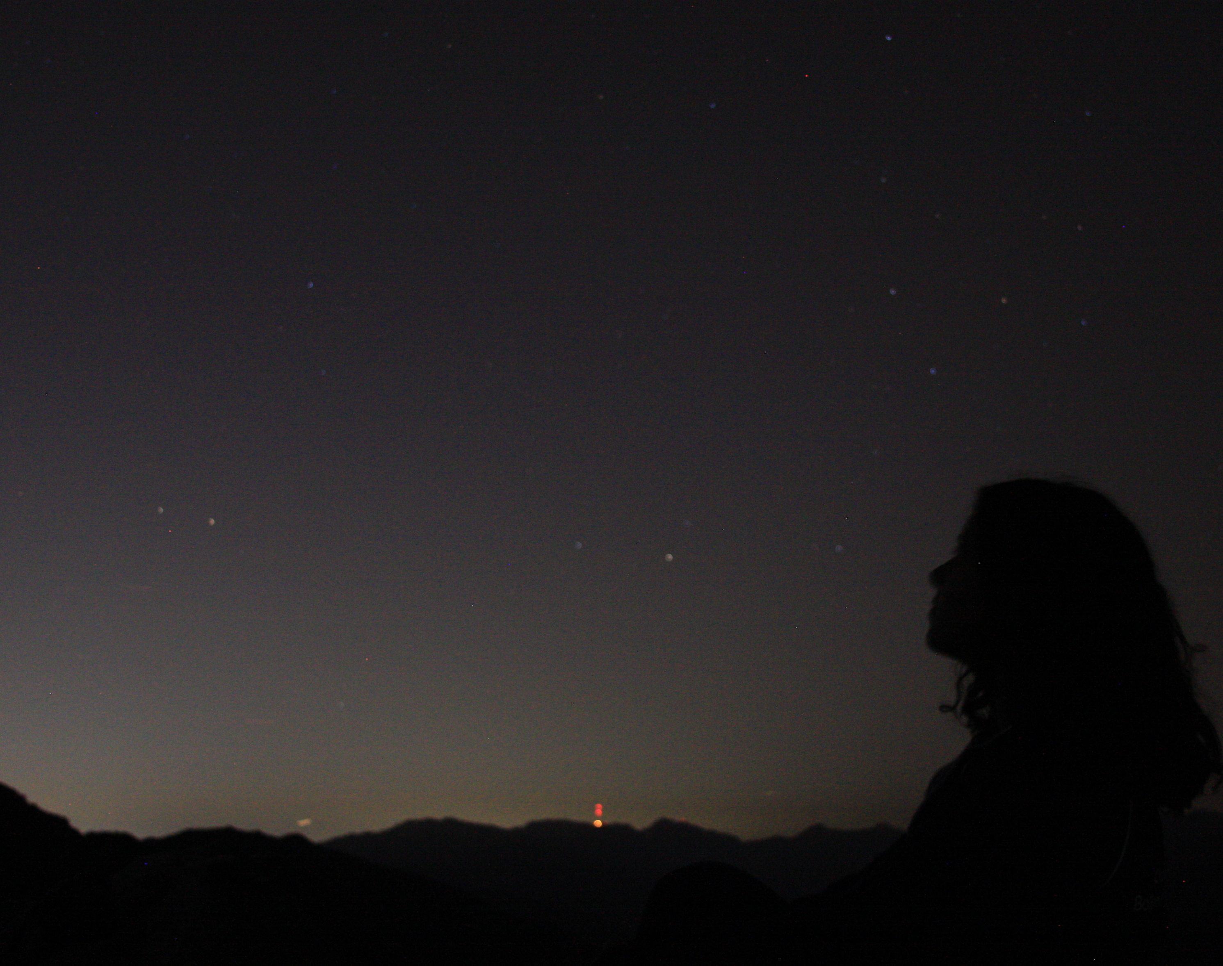
Astronomy 100/1 Lab 1
[subtitles]

Slide 2
Who are we?
Instructor: Prof. Stephen Schneider
Course coordinator and TA: Patrick Kamieneski
TAs: Yvonne Ban and Yingjie Cheng
Other section TAs: Luan Luan, Lisiyuan Yang, Sam Cutler

Slide 3
Scheduling
6 sections per week, all recorded, same link
Mon/Wed/Fri, 12.20 and 1.25 pm
Same content
Moodle: all the things
Recordings, materials, submissions
6 labs, 2 weeks each

Slide 4
How to get help
Astronomy help desk email
Astronomy majors can help with lab or lecture
Email us
Emails on Moodle

Slide 5
Grading
100% of lab grade makes up 25% of ASTRON 100/101 grade
Not grading attendance or participation
Interacting with us live is best, recommended
Others probably have same questions

Slide 6
Zoom orientation
Video and sound
Please mute your sound unless you are speaking.
Video feeds affect bandwidth, up to you
Chat
Ask questions
‘Private’ chats can be downloaded
Raise hand
Open participants panel and click ‘More’

Slide 7
Stuff you need
Computer
Lab 0 survey on Moodle
Camera
Can be phone, just be consistent
Access to sky

Slide 8
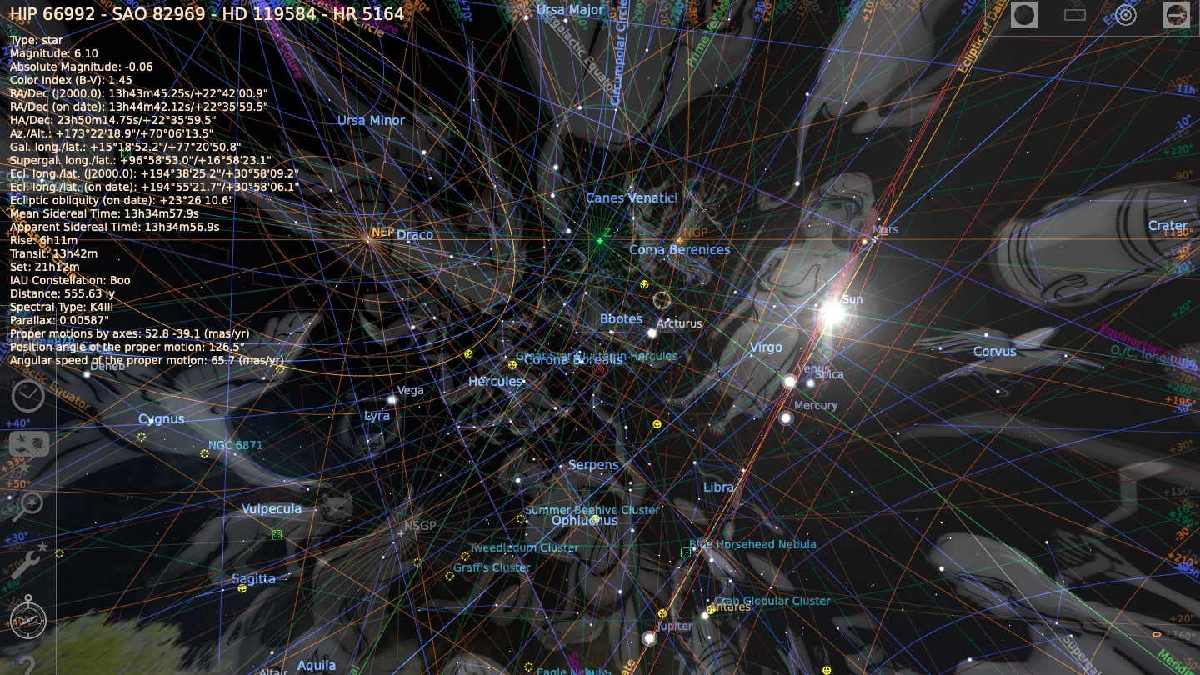
S T E L L A R I U M

Slide 9
Getting started
Download from http://stellarium.org/
Choose correct operating system
If you can’t find your OS, use Stellarium Web
Install as specified
Open location window, enter your location
Play around
Drag your view around
Zoom in and out
Set different times
Go wild!

Slide 10
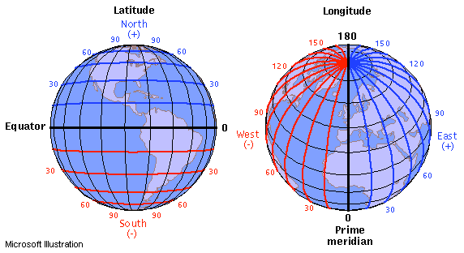
How do we find anything
Credit: ISU

Slide 11
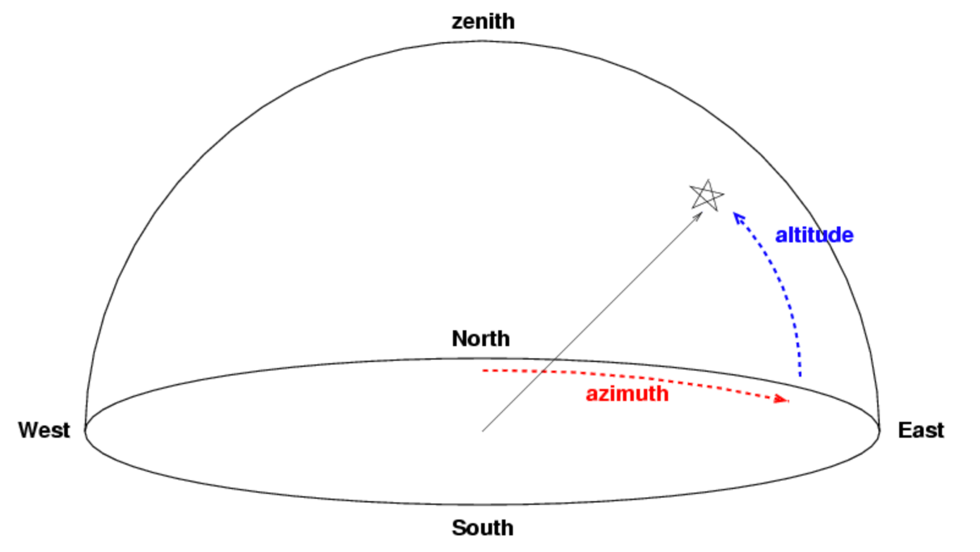
How do we find anything
90º
0º
0º
270º
90º
180º

Slide 12
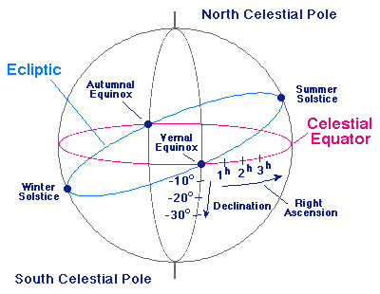
How do we find anything
Credit: http://www.pas.rochester.edu/~blackman/ast104/coordinates.html

Slide 13
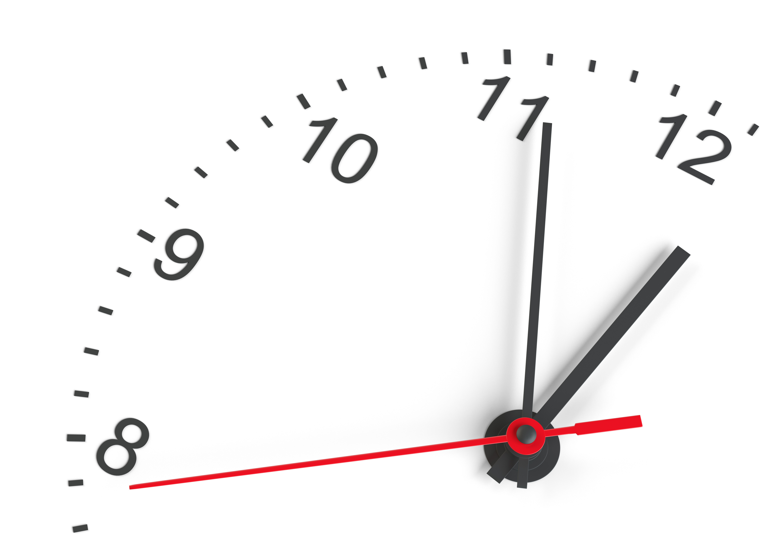
A minute about minutes
Angles are commonly measured in degrees.
For smaller angles, we use minutes, or arcminutes.
There are 60’ in a degree.
For even smaller angles, we use seconds, or arcseconds.
There are 60” in an arcminute.
There are 3600” in a degree.
Right ascension is measured in hours-minutes-seconds.
There are 24 hours in a circle of 360°.

Slide 14
Does it work?
Try it for yourself! Open Stellarium and click on an object!

Slide 15
Submissions
1 screenshot of Stellarium set to your location
Fill in the Lab 0 survey
NOT graded on correctness
Due next Wed, 2 Sept 2020

Slide 16

Welcome!

